Slide 1
What is MS – Excel?
Microsoft Excel is a computer application program written by Microsoft. It mainly comprises tabs, groups of commands and worksheet. It is mainly used to store tabular data.
Microsoft Excel is one of the most suitable spreadsheet functions that help us manage data, create optically logical charts, and thought-provoking graphs.
Microsoft Excel is supported by both Mac and PC platforms. Microsoft Excel can also be used to balance a checkbook, create an expense document, build formulas, and edit them.
It is a semi-structured database.

Slide 2
MS – Excel Features?
Features of MS-Excel | AutoSum
 | AutoFill
 | AutoShapes
 | Wizard
 | Charts
 | Pivot Table
 | Shortcut Menus
 | VBA

Slide 3
Some Basic Questionnaire?
What is Workbook?
What is Worksheet?
A workbook is a file that contains one or more worksheets to help us to organize data.
We can create a new workbook from a blank workbook or a template.
The term Worksheet used in Excel documents is a collection of cells organized in rows and columns.
Each worksheet contains 1048576 rows and 16384 columns to organize information.

Slide 4
Some Important Points
Extension of MS – Excel is .xlsx
(version 2007 onwards)
Extension of MS – Excel is .xls
(from version 1997 – 2003)
What do you mean by Cell?
A cell is the intersection of a row and a column. Columns are identified by letters (A, B, C), while rows are identified by numbers (1, 2, 3). A cell. Each cell has its own name—or cell address—based on its column and row.

Slide 5
MS – Excel Interface?
After starting Excel, we will see two windows - one within the other.
The outer window is the Application Window, and the inner window is a Workbook Window.
When maximized, the Excel Workbook Window composite in with the Application Window.
  Identify the components of the Application Window.
  Identify the components of the Workbook Window.

Slide 6
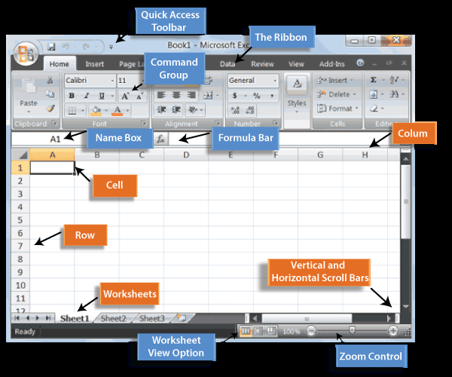

Slide 7
Application Window
After starting Excel, we will see two windows - one within the other.
The outer window is the Application Window, and the inner window is a Workbook Window.
When maximized, the Excel Workbook Window composite in with the Application Window.
  Identify the components of the Application Window.
  Identify the components of the Workbook Window.

